Slide 1
Media
TTS Accessibility Guild
GSA | Technology Transformation Services

Slide 2
Homework
How long did it take you to get comfortable navigating with a screen reader? What was the biggest hurdle?
Notes:
Nikki

Slide 3
Why does media matter?
Notes:
Robert

Slide 4
Using media like images and videos adds another dimension to your content. This is great for many people, but it doesn’t automatically play nicely with assistive technology.

Slide 5
We need to make sure that all of the media we use is available to assistive technology.

Slide 6
There’s no way for a screen reader to know what is in an image, let alone how it fits into the context of the page.

Slide 7
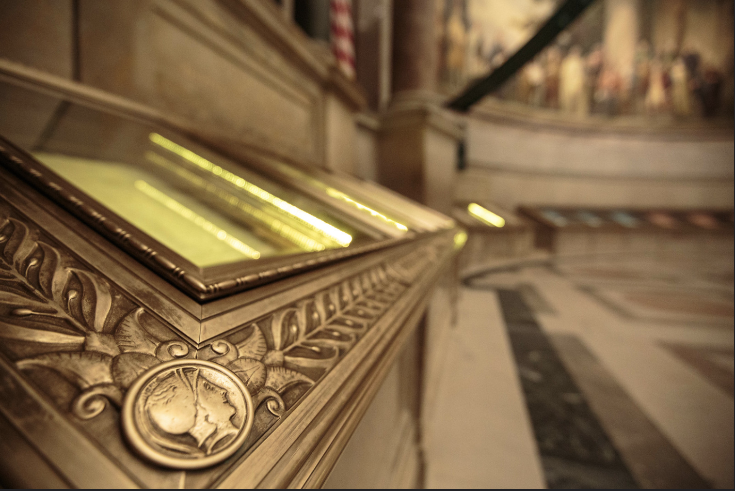
How would a screen reader know what this is?

Slide 8
We also need to guard against inadvertent actuations. For example, a deaf user may not know that a particular page is playing sound… leading to unexpected consequences when they visit that site in a public space.

Slide 9
Implementing media
Notes:
Nikki

Slide 10
1 / Make sure images have appropriate alt text.
Notes:
Nikki

Slide 11
You should provide an alternative to all non-text content, like images, videos, and audio clips. Except if they are purely decorative: then they should be tagged so that a screen reader knows to ignore them.

Slide 12
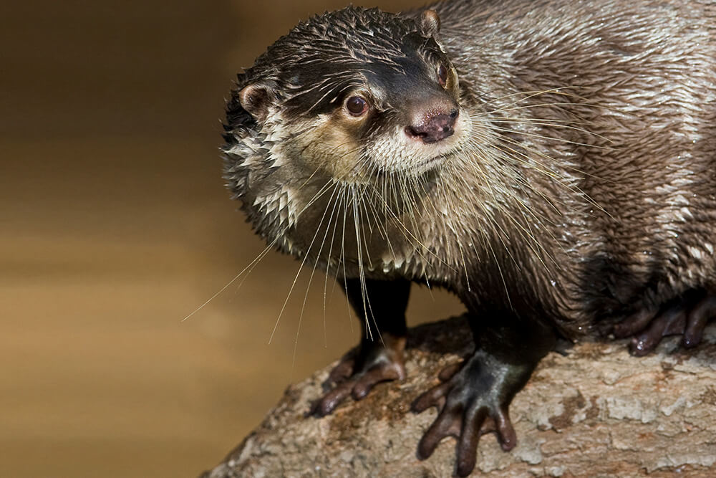
HTML
Display
Screen readers read the underlying HTML
<p>Otters are the only serious swimmers in the weasel family. They spend most of their lives in the water, and they are made for it! Their sleek, streamlined bodies are perfect for diving and swimming. Otters also have long, slightly flattened tails that move sideways to propel them through the water while their back feet act like rudders to steer.</p>
<img alt="African clawless otter displaying webbed feet" ...>
Otters are the only serious swimmers in the weasel family. They spend most of their lives in the water, and they are made for it! Their sleek, streamlined bodies are perfect for diving and swimming. Otters also have long, slightly flattened tails that move sideways to propel them through the water while their back feet act like rudders to steer.

Slide 13
HTML
Screen reader
Screen readers read the underlying HTML
<p>Otters are the only serious swimmers in the weasel family. They spend most of their lives in the water, and they are made for it! Their sleek, streamlined bodies are perfect for diving and swimming. Otters also have long, slightly flattened tails that move sideways to propel them through the water while their back feet act like rudders to steer.</p>
<img alt="African clawless otter displaying webbed feet" ...>
Otters are the only serious swimmers in the weasel family. They spend most of their lives in the water, and they are made for it! Their sleek, streamlined bodies are perfect for diving and swimming. Otters also have long, slightly flattened tails that move sideways to propel them through the water while their back feet act like rudders to steer.
African clawless otter displaying webbed feet, image

Slide 14
How to test
Open the page you want to test and run WAVE. The tool will tell you if there are any images missing alt text!
You can also use the developer tools in your browser to inspect an individual image and check for alt text.
If there’s no alt text on an image, you can cite 1.1.1 Non-text Content in your bug report.

Slide 15
2 / Provide text alternatives to audio content.
Notes:
Robert

Slide 16
Audio content should have some kind of text-based alternative. A transcript is a great option for pre-recorded audio, and live audio should have captioning provided.

Slide 17

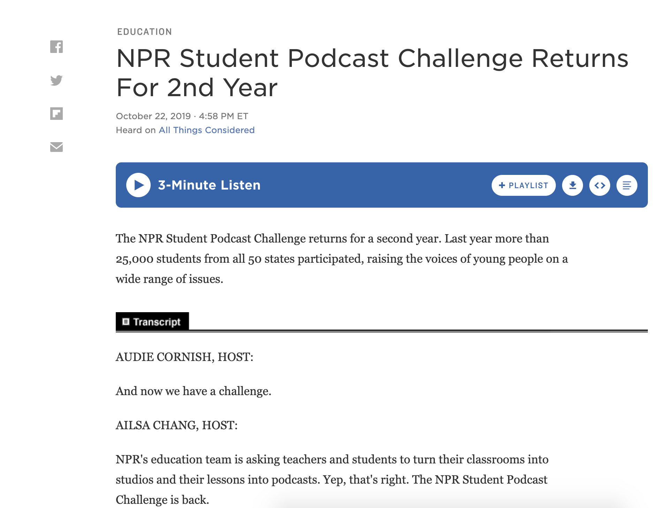
A transcript of the audio is provided on the page

Slide 18

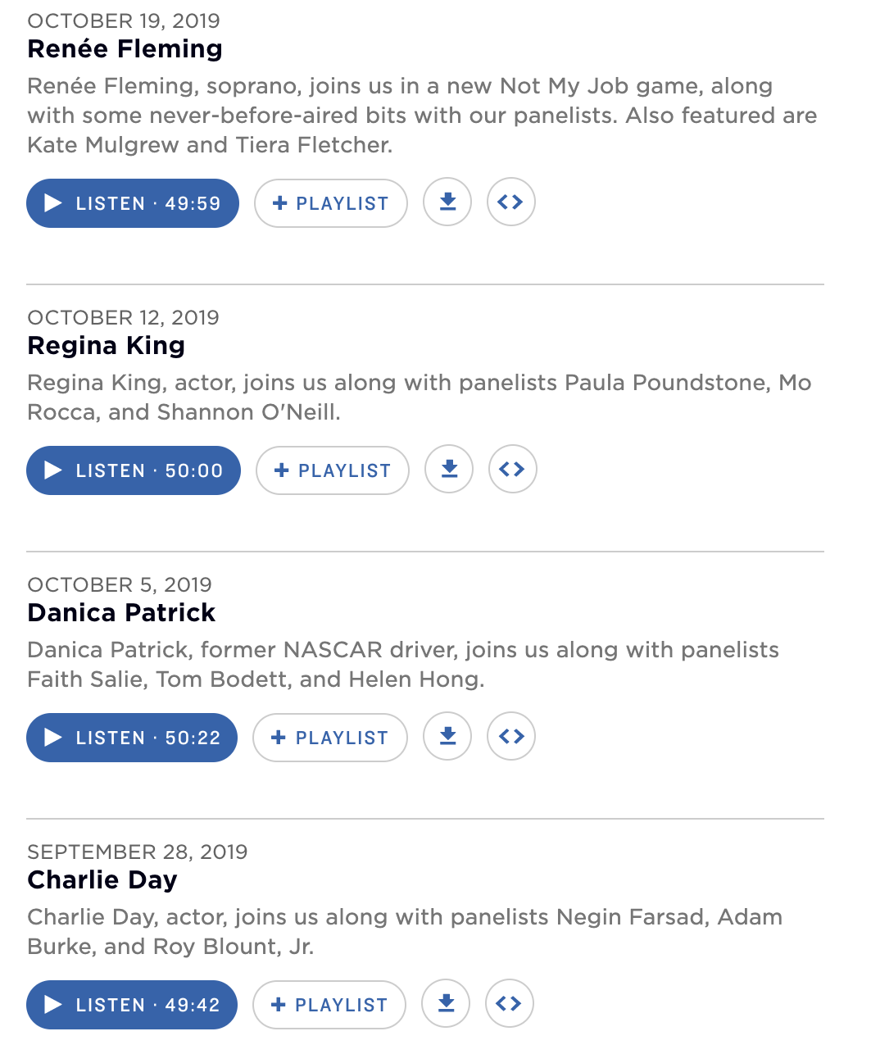
No transcripts are provided alongside the audio content of the podcasts

Slide 19
How to test
If you find audio content on a web page, and cannot find a text alternative, file a bug!
You can cite 1.2.1 Audio-only and Video-only (Prerecorded) in your bug report.

Slide 20
3 / Provide accessible ways to consume video content.
Notes:
Nikki

Slide 21
Sometimes you only have a video. In those situations, there is still a lot that you can do to make the video accessible.

Slide 22
There are two major things that can be done to make a video more accessible:
Provide an audio description of the visuals
Provide captions of any audio
Additionally, a full script can be helpful if watching a video does not work for someone.
Notes:
People on tik tok do this!

Slide 23
How to test
If you find video content on a web page, there are a few things to check:
Are there captions for the video?
Are they auto-generated or written by humans?
If autogenerated, are they accurate?
Is there an audio description of the video?
If there aren’t captions/audio descriptions, is there a text alternative (like a transcript or written script)?
If something is missing, you can cite 1.2.1 Audio-only and Video-only (Prerecorded) in your bug report.

Slide 24
What about live audio and video?
Live audio and video are much less common, so we won’t be focusing on that in this course. If you need more information, you can check out W3C’s guidance for Live Video.
Notes:
People on tik tok do this!

Slide 25
4 / Don’t lock users into interactive media.
Notes:
Robert

Slide 26
Interactive media like games and responsive widgets are a lot trickier to make accessible. A good baseline option is to make sure that users aren’t forced to use complex interactive elements to accomplish their goals.

Slide 27
If you can’t make it accessible, then build an alternative that is accessible. Of course, it’s almost always better to build one thing than two things.

Slide 28
Ground rules for interactive experiences
Accessible output
Provide captions or text alternatives
Make sure screen reader describes what’s happening
Avoid animations with flickering, flashing, or rapid shifts in perspective
Accessible input
Make sure that keyboard works, as well as mouse
Allows enough time for everyone
Avoid really precise input (ex. small cursor targets)

Slide 29
It’s ok to put these accessibility features into settings. For example, you might not want captions on by default – as long as users can easily turn them on, everything is fine!

Slide 30
How to test
Check all of the ground rules for interactive experiences. Focus on checking both the input and output — while not all of the criteria are black and white, you’ll start to develop a sense of what is and is not problematic over time.
You can use 1.2 Time-based Media, 2.1 Keyboard Accessible, 2.3 Seizures and Physical Reactions, and 2.5 Input Modalities as a starting point.

Slide 31
Questions?

Slide 32
Homework
Notes:
Robert

Slide 33
Assignment #4:
We have two websites for you to look at. Spend 10 minutes on the first and 20 minutes on the second.
This YouTube video has captions, but it doesn’t have an audio description. Write a description of the video to help a blind user contextualize the audio. Try to write a description that would create an equivalent experience, not just one that is factually accurate.
Take a look at this web page. What media problems can you find? Does the page work with a screen reader?

Slide 34
Thanks!
Slack #g-accessibility

